Slide 1
On-prem DC and outlook

Slide 2

What do future on-prem DCs look like?
What are the building models of future DCs?

Slide 3
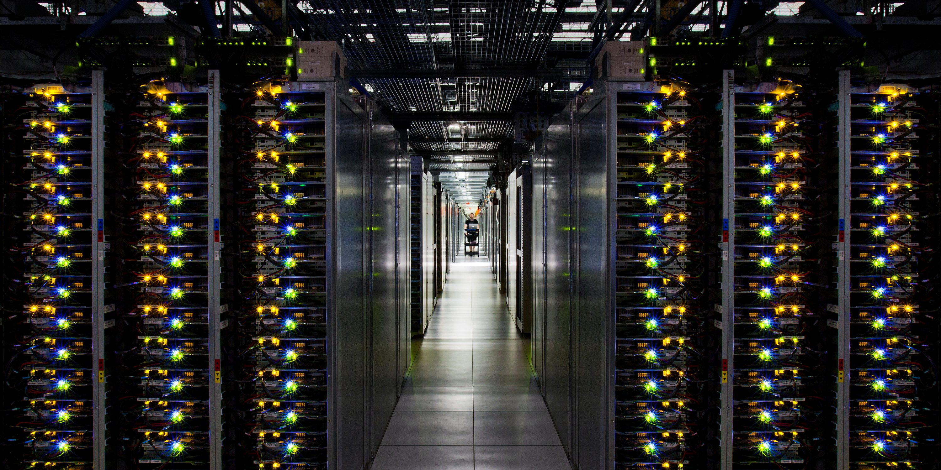


On-prem DCs must evolve
IDC survey shows
76% of customers ask vendors to take over operation
73% of customers plan to use pay-as-you-go
On-prem DCs
O&M becomes vendor’s responsibility, but users want elasticity, agility, and low cost
Software defined solution
Purpose-built solution
A mixed solution
Public clouds
On-prem DCs can provide a solution that is close to customer needs.

Slide 4

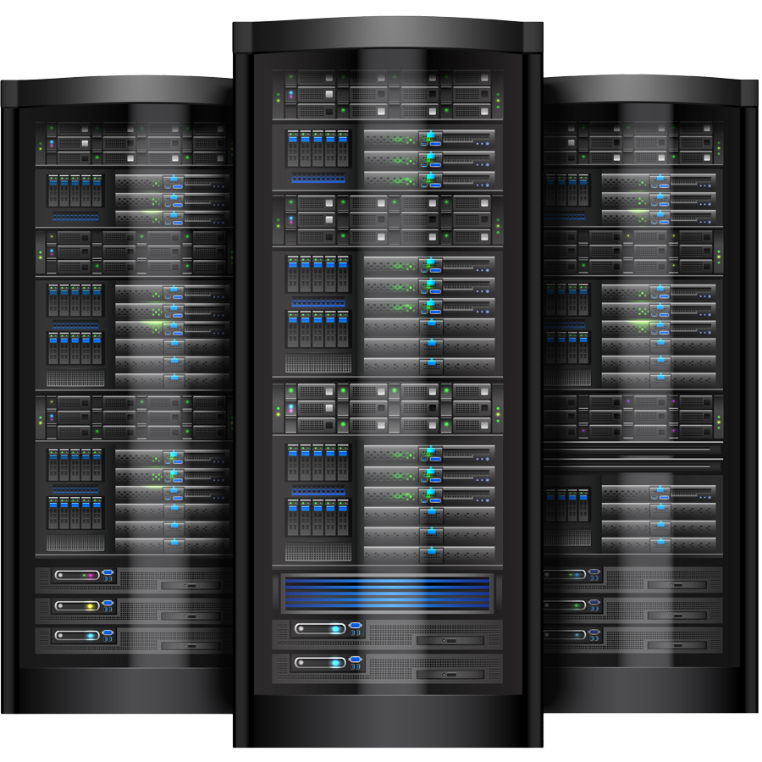
Enterprise lifecycles
May change after growth
May change after growth
Non-cloud Hyperscalers/
SaaS
Startup
Established
Startup
Pick between cloud and on-prem
Multi-cloud, multi-DC
Build own data centers

Slide 5
Two business models
更容易构建内部服务化能力
Traditional mode
Pay-as-you-go mode
Enterprise IT
内部服务化能力
Enterprise IT
Total resources
Total resources
Software-define
Purpose-built
Traditional On-prem
Pay-as-you-go On-prem
Enterprise’s responsibilities
Features
Utilization rate
Cost
SLA
O&M
…
Vendor’s responsibilities
Vendor’s responsibilities
Features
Utilization rate
Cost
SLA
O&M
…
服务化能力

Slide 6
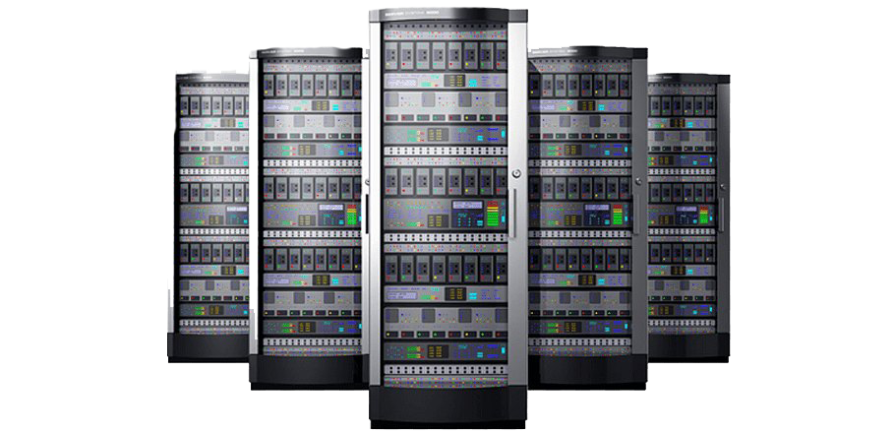
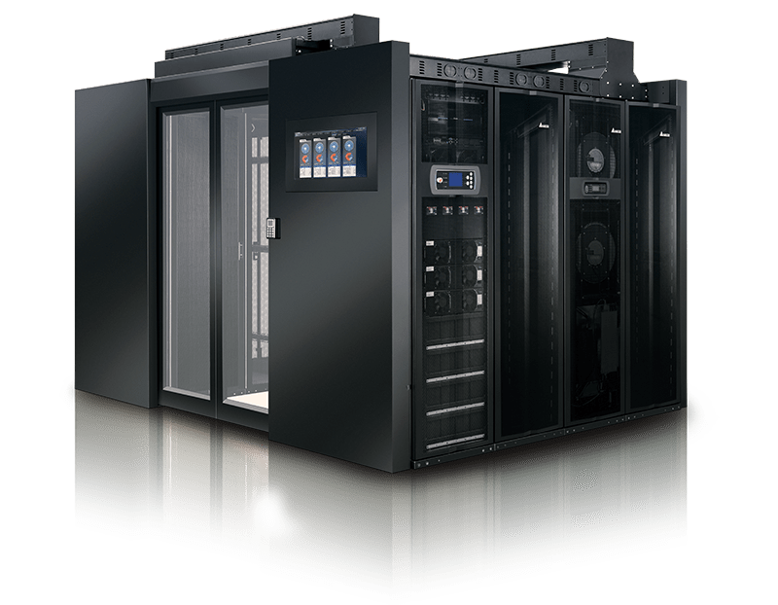
Multi-vendor/multi-cloud
Multi-realm composer
Multiple-realms from different vendors
Software-define
Purpose-built
Software-define
Purpose-built
Pay-as-you-go
Pay-as-you-go
Pay-as-you-go
Public cloud
Realm 1
Realm 2
…
Realm N-1
Realm N
Pay-as-you-go mode with multiple vendors

Slide 7
1
Mixed software define and purpose-built platform
10
Pay-as-you-go business model
2
ROI-based platform with hardware as a differentiator
9
Fast DC expansion with quick delivery and scale out
Customer needs &
Vendor needs
3
8
Automated management
Agile service change request
7
New edge applications can be integrated quickly
4
Power efficient
5
Interconnection and application movement among other data infrastructures
6
Provide common cloud-native DevOps and data services

Slide 8
Part 1
未来数据中心一个进化方向是硬件offload模板化定制化提高效率降低成本，另一个方向是软件定义提高敏捷度，同时对解决方案硬件加速。但两个方向未来会互相融合。比如，一个同时包含软件化DC和硬件方案加速的基础设施方案能够提供敏捷度和性能。
数据中心的用户看重软件服务质量和生态，硬件差异化是未来提供更好服务和ROI的核心竞争力。比如，量化不同平台的ROI。在服务化发放的前提下，一个能够增加提供商ROI的平台就会提高利润率。而硬件的差异化能保证客户的SLO。
On-prem数据中心也越来越注重敏捷度，并以服务化的方式提供。比如，用户的诉求是能够挑选所需要的服务，并且这些服务可能是不断变化的。如果客户要求在一小时内变更不同服务间的分布情况，作为供应商如何低成本的满足？
数据中心使用率和机架密度要提高，单位能耗要降低。比如，在满足用户SLO的前提下，节能减低采用低功耗设备，在服务化模式下成为一个管理问题。
支持跨界基础设施层面的互联互通，和数据及应用的跨界流动。On-prem和边缘以及云的数据流动和应用搬迁。比如，能力构建支持和兼容业界的头部平台，以及大量的第三方软件生态支持。

Slide 9
Part 2
提供业界通用的云原生DevSecOps服务以及数据服务。比如，全套的云原生环境服务，包括开源的和第三方软件。数据服务包扩数据库，大数据，以及数据共享等等。
边缘应用和边缘数据中心正在快速增长，产生新的趋势。比如，边缘新应用的接入和部署问题。数据服务在边缘的形态和ROI。
继续智能与自动化的数据中心运维，降低管理成本。比如，自动运维减低TCO。
数据中心建设需要系统快速scale out和交付能力。比如在on-prem服务化场景下，如何快速弹性扩容。打通物流环节，用小时级在数据中心解决容量问题。
数据中心用户需要Pay-as-you-go商业模式。比如，扩大融资能力，提供给客户self-provisioning和付款的通道等等。

Slide 10
What do future on-prem DCs look like?
What are the building models of future DCs?

Slide 11
Summary
技术趋同化。随着云原生的流行，以及开源社区的公开性，数据中心建设越来越趋同。好的特性与技术被不同厂家很快的吸收，推出类似的产品。这时候如何内部做好成本管理，外部做差异化特性就很重要。
产品服务化。同样随着云服务理念的流行以及用户认可。On-prem数据中心的服务化越来越明显。用户喜欢直接比较On-prem以及公有云的服务。On-prem的定制化选择的可能性可以帮助用户得到最合适的服务，也是和公有云竞争的优势。
选择多样化。保持统一服务界面的同时，在技术栈的每一层，客户都有很多的细分选择，包括异构计算。比如CPU，可以选择x86, ARM®, Power® systems。加速芯片也有很多家供应商或者自制。在操作系统可以选择各种Linux®或者windows®。在虚拟化可以选择各种VM以及容器化。在存储可以选择各厂家方案。虽然服务化之后，许多细节是不可见的，但是反映在性能和成本上，服务的质量和费用是不一样的。
on-prem多种形态存在。规模小型或大型化。两头都有优势，而计算需求和与云竞争的规模经济使自己建立和管理中型数据中心慢慢失去成本优势。中型数据中心可以从给客户提供独特价值出发，然后通过提供商的供应链整合产生的低成本，来获得竞争优势。
成本敏感化。很多选择都是基于成本。比如大型化之后，一点百分比都有很大影响，产生定制化需求。提供商可以抓住这个机会，提供多元化定制服务，提供更优惠的价格给客户。
能耗加大化。每机架和数据中心能耗继续扩大。由于高密以及AI等应用，每U的能耗在不断增加。这时候提供商的能源管理策略就能做出差异化。
强调sustainability，能源绿色化。数据中心绿色能源继续流行，比如太阳能和风能。提供商能做的还有采用可回收部件，妥善处理回收的旧设备，等等。
混合云随着on-prem和公有云的发展继续进展。前面也提到供应商要打通市场上其它的主要平台和第三方应用。

Slide 12
Different sized DCs today
Software defined
Edge
Telecom
Mid-size enterprise
Small enterprise
IoT
Large enterprise
Hyper-scaler
Small-scale
Large-scale
Purpose-built

Slide 13
Evolution
Majority vendors
Improve
performance
Hardware accelerated SDCC; composable with software define
Improve
agility
Software defined Data center (SDCC)
Standardization
Next-gen enhanced equipment for data centers
General equipment for data centers
Offload to purpose-built
Purpose-built optimized hardware
Improve
agility
Composable infrastructure with optimized hardware
Improve
performance
Mass production
A few vendors

Slide 14
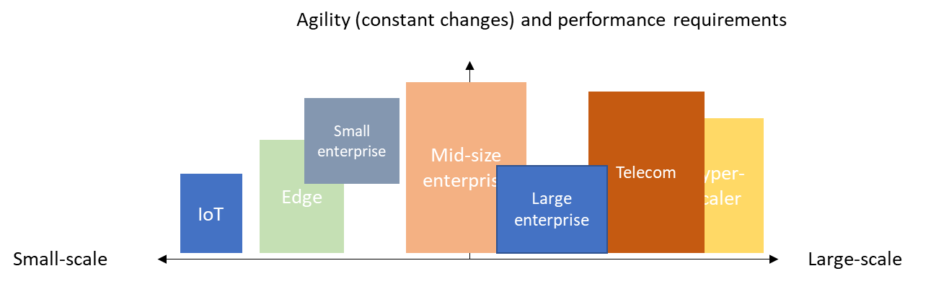
Simplified model in PayU
Related to user’s business needs

Slide 15
Challenges
数据中心资源利用率仍然偏低
提高能源利用率，从而使同样规模的数据中心能提供更多的计算资源
继续提高ROI，降低TCO
数据中心管理，SLO和自动负载调度(e.g., AI-based)
self-driving data centers
数据安全
数据价值挖掘
容灾和数据保护
Responsibilities of vendor or user
Responsibilities of vendor and user

Slide 16
Predictions
on-prem数据中心会朝以定制化降低成本提高效率以及提高敏捷度两个方向进化。性能加速后的软件平台和定制硬件吸取各自优点，开始融合。低效又不敏捷的数据中心会被市场淘汰。所以供应商要赋能用户，让他们更敏捷和高效。
更超大规模的数据中心由于资源(e.g., 电力)的限制不会更经济。大型数据中心的尺寸会在2030年左右达到瓶颈。所以地理分布的多数据中心和规模大小不等的跨界基础设施的支持会很重要。
随着更多企业采取数字第一（digital-first）战略，更多的变化会发生在边缘，小型数据中心可能会看到一些新的形式。而大型数据中心的建设格局和模型会延续这些年新兴的模块化建设风格，因为大型数据中心是多年期的投入（船大难掉头）。意味着现在的头部厂商仍然在大型数据中心的建设方面有先发优势。
由于计算密度和能力的提升，小型数据中心会具有现在中型数据中心的性能，而在占地供电等方面更经济，会分散部署在各地。小型数据中心的潜力很大，如何能够更好的服务用户，把用户留在分层分布的基础设施上是一个进一步探讨的方向。
On-prem数据中心的服务会慢慢标准化和模板化。一个原因是公有云和on-prem大厂商在推动用户习惯的改变，另一个原因是客户自己也会尝到模板化带来的好处。模板化和定制化并没有冲突，模板化是用户界面上的，而定制化是为了实现降本增效。
向公有云搬迁和向on-prem搬迁的趋势同时存在。更需要弹性的向公有云移动，更需要成本以及控制的客户向on-prem方向移动。最关键的还是提供合适客户，并敏捷的解决方案。On-prem的服务化一定要比现在做的更好。

Slide 17

Hot trend topics

Slide 18
From application-centric to app-data-centric
Microservices, container, and DevOps are making the applications agile
The application and data are more in control of the Line of Business (LOB) level.
as-a-service带来的用户习惯改变
大中小形态的数据中心支持不一样

Slide 19
Virtualization progress
Reasons why serverless is not yet popular in on-prem settings:
The ecosystem for serverless-based applications is not mature.
Many serverless-based applications are not optimized in performance.
On-premise vendors are not eager to provide serverless PAYU modes. The profit is not proved to be high with the limited amount of usage.
For traditional on-prem models, serverless is only cost-related. The current business model does not trigger the necessity to adopt serverless.

Slide 20
Edge Revolution
AI and cloud are two trends that will be combined with IoT on edge.
From a data center perspective, edge data centers are deployed near the edge. The granularities can be different.
The new trends of PAYU, agility, elasticity and efficient data processing are making progress in the edge computing world.

Slide 21
Real-time/near real-time processing
Academia and industry are very interested in this area.
There is a niche market for purpose-built hardware for extra processing capability.
The majority of customers are not bound to an extreme latency and hence existing solutions such as open-source-based solutions are sufficient.

Slide 22
Multi-cloud
Multi-cloud is already an overused term in the industry. There are at least two types of multi-cloud integrations:
Use other clouds as an extension (for backup, DR, migration, etc.)
Use other clouds as peers

Slide 23

数据中心非传统视角下
Hot DC building tools

Slide 24
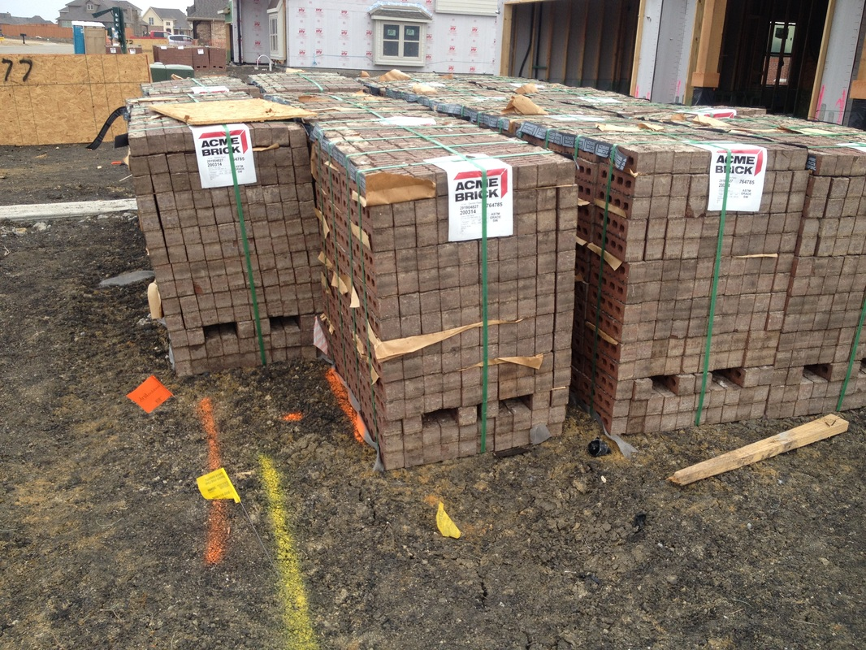
Mixed pools and the composable infrastructure
Gartner® defines composable infrastructure as a “highly flexible software architecture that leverages standard hardware building blocks that can be easily scaled-up, scaled-out, scaled-down, or scaled-in as business needs dictate”.
Composable的主题是灵活pooling (CPU, xPU, Mem, etc)，美好的愿景
一派比较早，想法是纯的，从硬件解决。但是产品迟迟达不到期望。
另一派是比较现实的，认为软件构造出概念就好。
Gartner和IDC支持第二种观点，但是并不排斥purpose-built.

Slide 25
Bundle, various forms of convergence, and xPUs
The various forms of convergence architecture clearly define the implementation
In the PAYU model, customers choose to ignore the differences between CI, HCI, and dHCI
更多的市场和商业策略问题，不同尺寸下，哪种配置ROI最高
The xPU movement impacts the co-processing market deeply. Using co-processors or accelerators can provide better ROI for customers
the benefits of software-defined or purpose-built are internal to service providers.
Therefore, the freedom could cultivate a group of new exciting solutions having new tradeoff standards

Slide 26
Silicon customization and the merge of processing units
All kinds of xPUs
chiplet is a proposed way to embed pre-designed dies into a foundation.
This is an example of the endless cycle -- software-defined solutions and purpose-built solutions will merge and generate new general-purpose solutions. Silicon customization used to be in the purpose-built area. Soon the flexibility issue limits the speed of integration. Hence, the industry is using the concept of chiplet to overcome flexibility issues.
Chiplet的灵活度只能和xPU比，暂时还比不了软件定义。但是可以加快从软件优化到硬件优化的过程，从而提高灵活度。

Slide 27
Serverless and function-as-a-service
Serverless is an extreme form of software-defined infrastructure
function-as-a-service is very friendly to data analytics and AI workloads.
Some of the serverless applications are possibly be adopted first:
Big data processing applications
ML applications
ETL pipelines
Batch jobs
On-prem setting function-as-a-service is only meaningful when the vendors find a win-win way to obtain enough profits from providing such a service. The risk is that the ROI is so small or even negative when only a few people adopt this service.

Slide 28

数据中心传统视角中的存储

Slide 29
Overview & background from IDC numbers
While growth in the Worldwide External Enterprise Storage Systems market will slow from 7% to 2% in 2022-2025, revenue will reach $36.9 Billion in 2025.
The worldwide enterprise storage market (Worldwide Enterprise Storage Systems) grew at a higher CAGR of 7.5%
A total of $177.1 Billion by 2025, which also includes OEM, and ODM markets, such as server built-in storage
SAN market is steadily growing
Distributed storage, including File/object and virtual SAN/HCI, is steadily growing

Slide 30
File and object (FOBS)
All numbers are from IDC reports
On-prem files/objects have growth in 2022-2025,
from 8 Billion to 8.4 Billion.
Many vendors compete in this markets
竞争激烈
所有容量中，
对象：公有云80%，on-prem6%，竞争需要策略
文件：公有云8.4%，on-prem5.6%
对标公有云，on-prem文件竞争力比on-prem对象竞争力强
The scale-out NAS will grow at a CAGR of 11%, and by 2025, it will become three times the revenue of Scale-up.

Slide 31
Virtual SAN and HCI
IDC predicts that the VSAN market is growing rapidly.
The CAGR is expected to be 11.6% through 2025.
From 6.7 to 8.8 Billion in 2025, more than the market for files and objects.
There are plenty of opportunities to accommodate new products and vendors.

